Slide 1

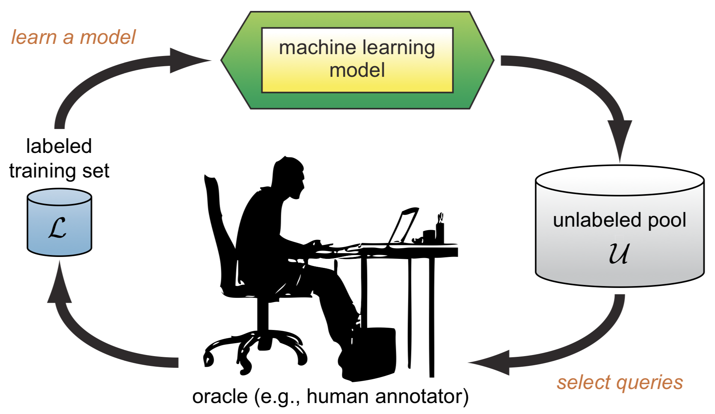
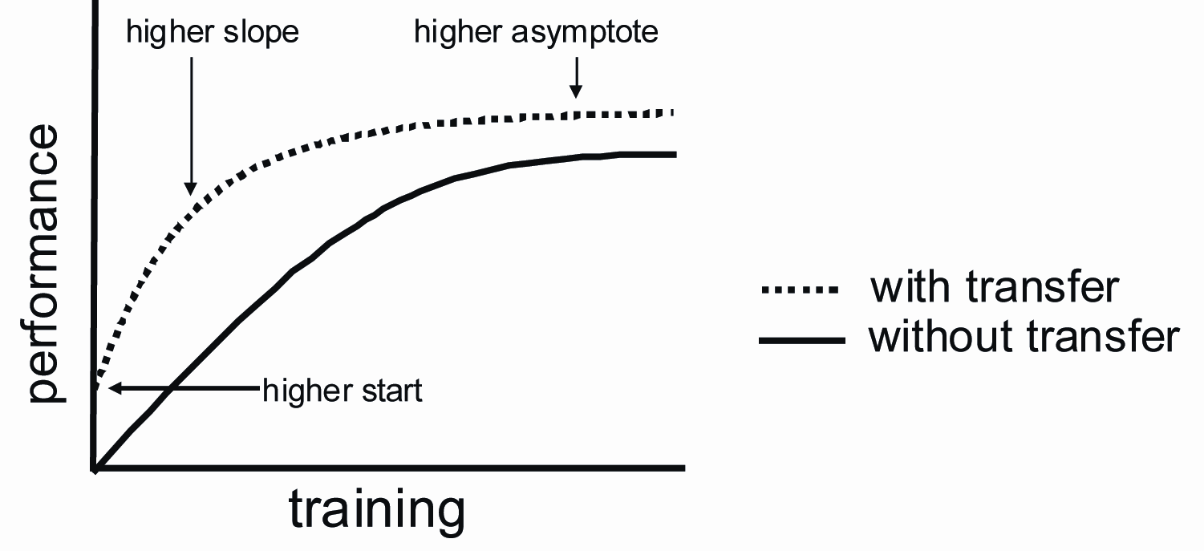
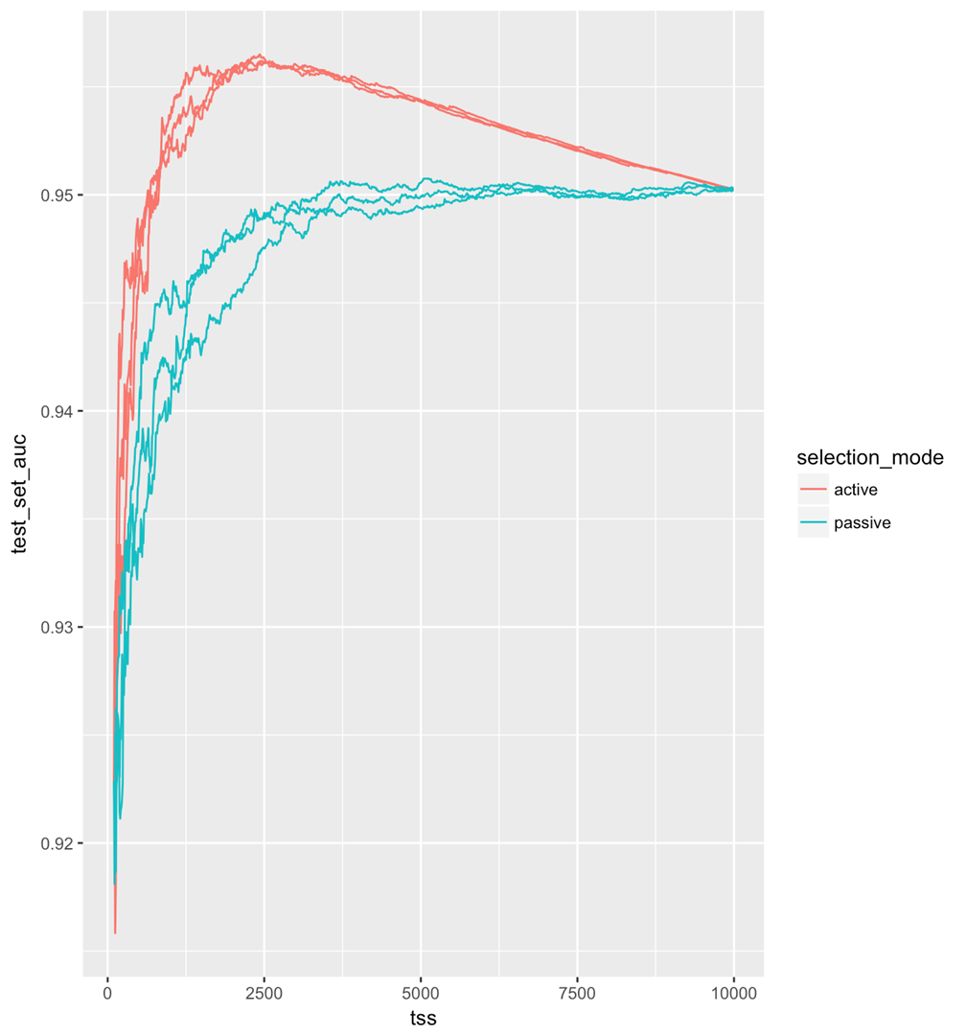
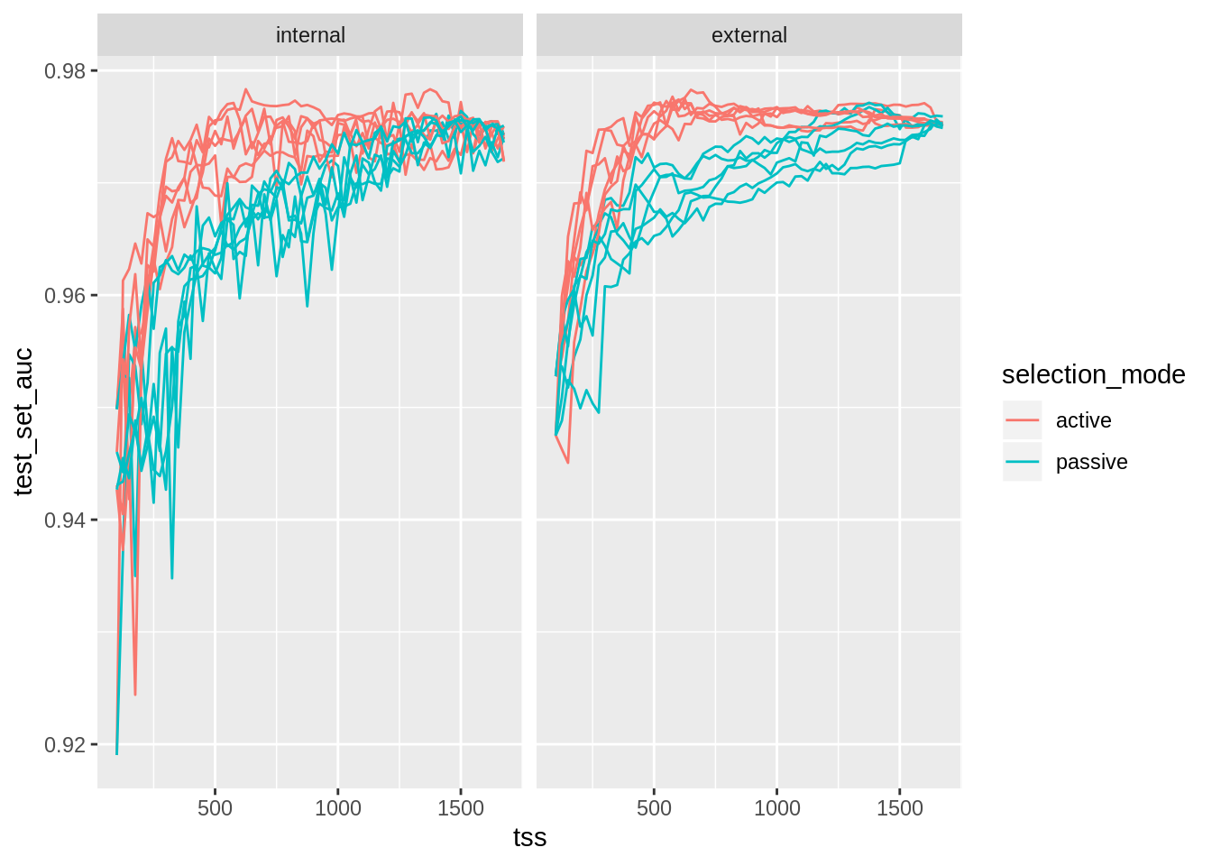
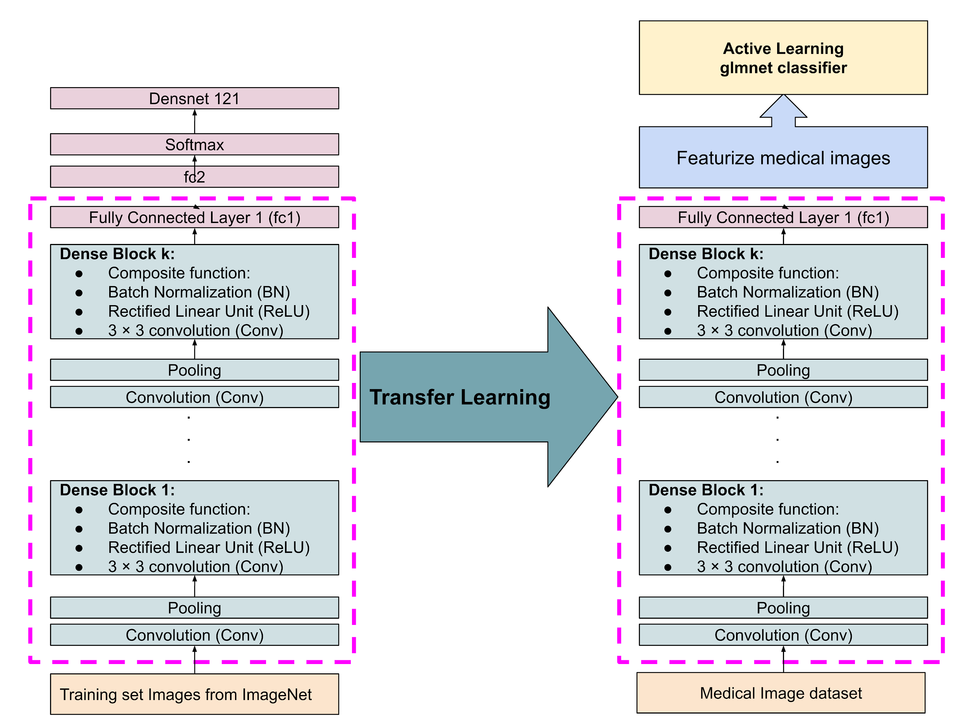
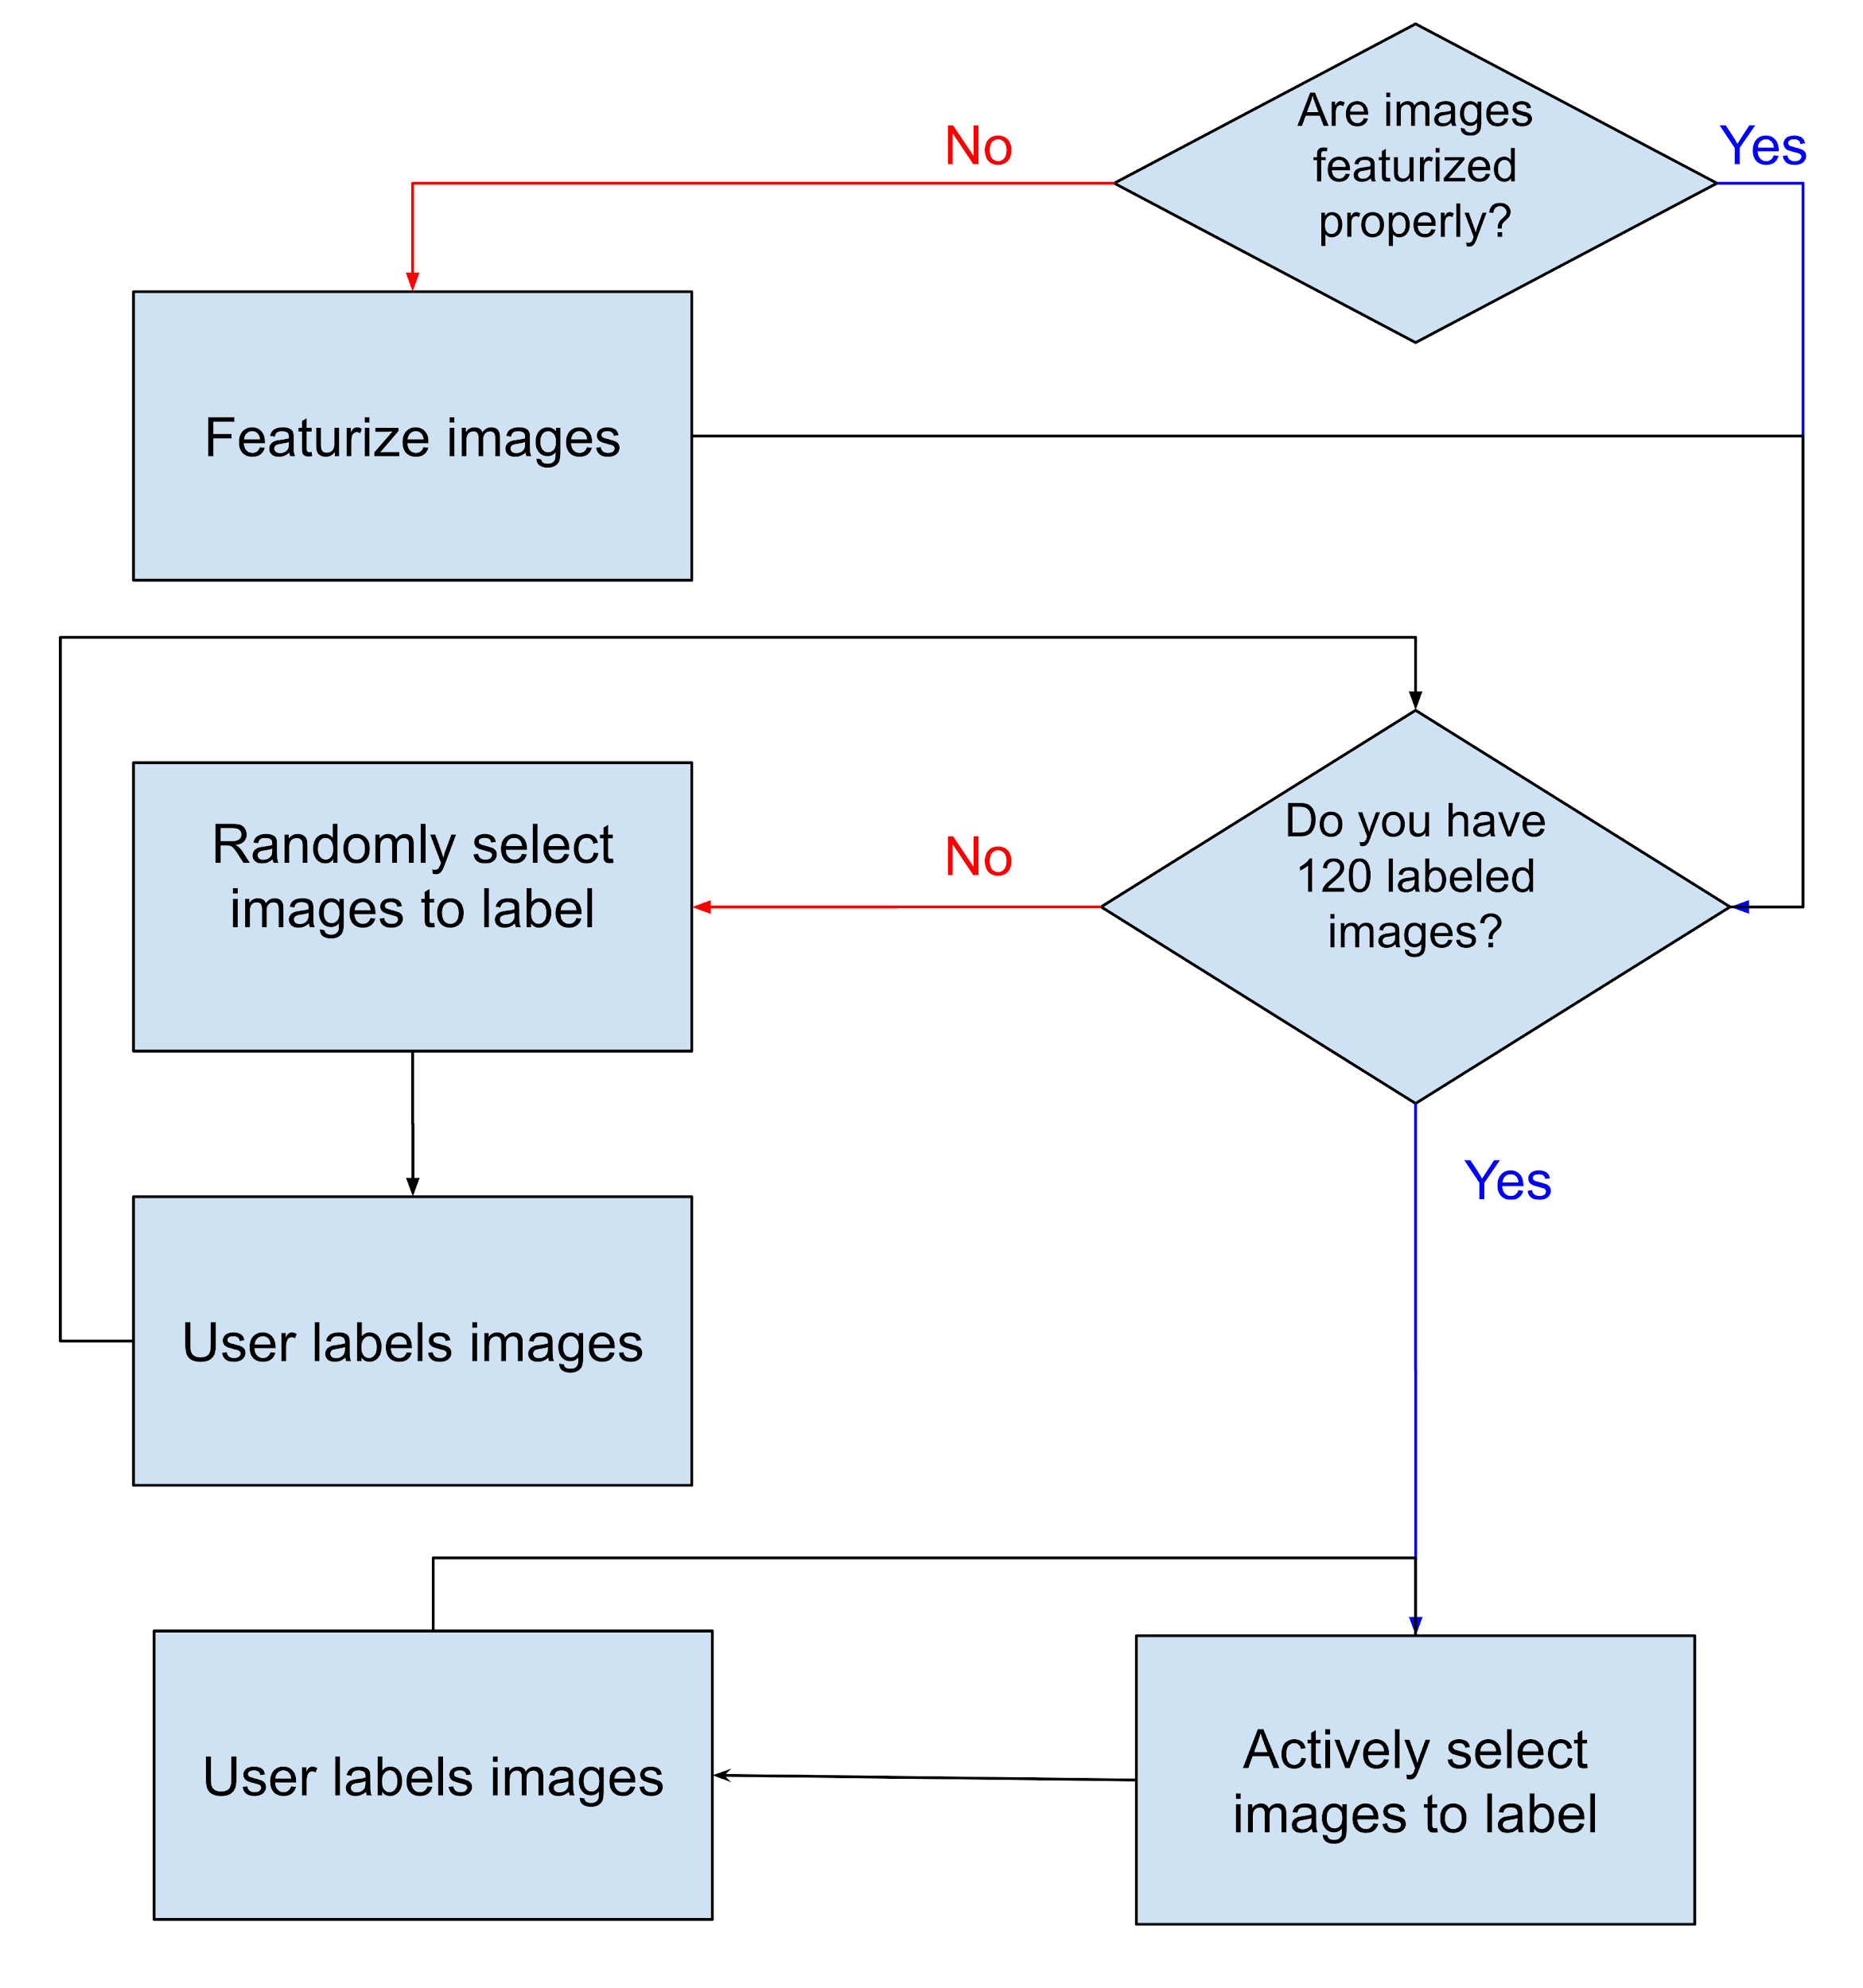




A COST-SAVING MEDICAL IMAGE LABELING APP USING TRANSFER LEARNING & ACTIVE LEARNING
Tyler Iams, Omid Khazaie, Soodabeh Sarafrazi
College of Art and Sciences, University of San Francisco
ACTIVE LEARNING
ABSTRACT
TRANSFER LEARNING
Traditional supervised learning models use labeled data that is available to induce a model. An active learning algorithm, on the other hand, chooses more informative unlabeled data , and query for labels from a user (or some other information source). This way a learner begins with a small set of labeled data, and selectively adds to it. The goal is to achieve greater accuracy with fewer labeled training instances and therefore, reduce the total labeling cost. Active Learning is well-suited when unlabeled data is abundant, but labeling is expensive.[1] In this project we are using the Ridge Regression model for the Active Learning analysis. At each training steps, the model returns the least confidence cases using
Cross-entropy loss. These cases then will be
sent to medical professional for labeling.
Then we re-train the model again and again.
Unlabeled image data is widely available and accessible across the web and within most major global industries. Within the health-care industry, applying diagnostic labels to images is often quite expensive, as only a qualified professional can accurately classify things like X-Ray images, MRI images, and various other scans. Therefore, when creating a mathematical model that attempts to perform image classification tasks on large amounts of (mostly) unlabeled data, it is critical to choose images that provide the maximum amount of information to the model about the classification task. Active Learning is a process by which a subset of labeled image data is used to train a model, and that model is used to generate the probabilities of each image in an unlabeled subset belonging to a particular class. These probabilities can be used to quickly generate a better model with the rationale that the least confident predictions made by the initial model provide us with the images that provide the most information about the classification task. Further, transfer learning is the process by which an existing Artificial Neural Network is repurposed for the featurization of unlabeled data. In this project, our group combined the techniques of Transfer Learning and Active Learning to various datasets to generate mathematical models to quickly, and accurately, classify images from a dataset, using minimal labeled image data. We created a Web Application that allows users who may not have the computer science or statistical modeling skills to accomplish this task on their own, to accomplish the task.
The main idea behind Transfer Learning is that the “knowledge” that a model has learned from a previous task, is transferred to current one. Transfer Learning is a common practice in image processing today. Therefore, we leverage whatever network parameters that model has learned through its extensive training before, without having to do that training ourselves from scratch. Transfer learning has shown to boost accuracy and reduce training time.[2] In this project, we use Transfer Learning for featurizing eachmedical
image to a single vector with
hundreds or thousands of features.
Then we perform the Active-Learning
on these sets of vectors.
Figure 1.1 Figure 1.2
In Figure 1.1, the Active model has a better performance compare to the Passive (random) model for the first 8,000 training set cases. But, the Ridge Regression model needs parameter tuning for lambda which is presented in Figure 1.2 using Internal and External cross-validations. The internal cross- validation is not stable (still under research). However, figure 1.2 with the X-ray dataset shows a unique case that the Internal cross-validation is fully functional. Since cross-validation gives the worst results with Active Learning, we are using the reverse psychology as when the cross-validation results are the worst, we know that Active Learning is performing better for tuning the lambda value.
AUC
Active Labeling
Passive Labeling
Training Set Size
Figure 1.1 Active Selection Learning versus Passive Selection Learning without tuning lambda
Figure 1.2 Active Selection Learning versus Passive Selection Learning with Internal and External Validation to tune lambda
Figure 2. Modeling diagram
Figure 3. R Shiny app design flowchart
DATASETS AND MODELING
IMPLEMENTATION
FUTURE WORK
Datasets: We used the following imaging datasets in this app:
Chest X-Ray Images (Pneumonia) - kaggle [3]
5,863 labeled images of Chest X-Rays
2 categories: Pneumonia/Normal
Malaria cellular imaging dataset
Skin Cancer dataset
Models: We used the following pre-trained keras models:
InceptionV3
Xception
VGG16
VGG19
MobileNetV2
NASNetMobile
DenseNet121
Transfer Learning:
we used keras pre-trained Keras models and developed packages for featurizing images in python. Then, we will call these functions in R using reticulate library.
Active Learning:
we used R to developed the active learning models.
Web Application design:
We used R Shiny to develop our application that user interacts with.
Research on figuring out a strategy to find the best possible points for tuning the lambda values in Internal Cross-validation for Active Learning. If the internal cross-validation works properly, we will not need a few hundreds labeled samples for our external validation which save us around 40% of the initial labeling cost.
Develop more features for transfer learning by running different models on the input dataset and suggesting the best model for that specific dataset to featurize images.
Tuning the Active Learning parameters and use alternative models
Design the application interface in python and Django
Plan for scaling the application to work in multi-user platform.
ADVISOR:
Dr. Robert Horton, Senior Data scientist at Microsoft
[1] Settles B. Active learning literature survey. University of Wisconsin-Madison Department of Computer Sciences; 2009.
[2] Torrey L, Shavlik J. Transfer learning. InHandbook of research on machine learning applications and trends: algorithms, methods, and techniques 2010 (pp. 242-264). IGI Global.
[3] Kermany, Daniel; Zhang, Kang; Goldbaum, Michael (2018), “Labeled Optical Coherence Tomography (OCT) and Chest X-Ray Images for Classification”, Mendeley Data, v2 http://dx.doi.org/10.17632/rscbjbr9sj.2

